Slide 1
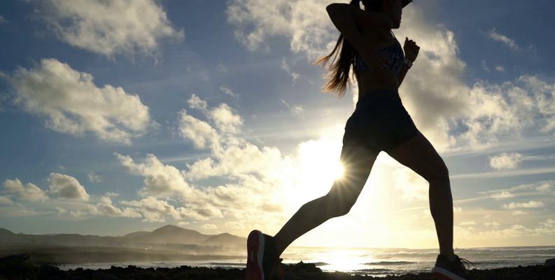
BELLABEAT
Smart devices for women’s health

Slide 2
Can trends from current fitbit users inform Bellabeat’s marketing strategy?

Slide 3
Agenda and goals
Bellabeat is:
A high tech company that focuses on women’s health
Determined to empower as many women globally as possible
Members are currently:
Tracking calories, activity levels, and movement daily
Tracking sleep patterns and heart rate
Possible future considerations:
Survey users for fitness level
Survey users to find what they look for in a fitness tracker

Slide 4
Study design
Who:
Data collected from 30 eligible FitBit users
What:
Minute-level, daily output for physical activity, heart rate, and sleep monitoring
When:
Data collected from 03/12/2016 - 05/12/2016
How:
Organized by Tracker, Session ID, and timestamps

Slide 5
Data Manipulation
Data integrity and reliability:
“FitBit Fitness Tracker Data”- Open source at Kaggle.com
Cleaned with Excel & BigQuery
Analyzed with BigQuery
Visualization created in Tableau

Slide 6
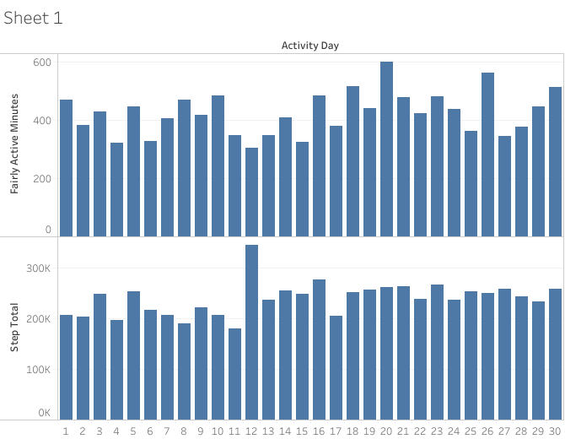
Activity Measured Daily
Daily Active Minutes
Daily Step totals
30/30 entries: each user tracked activity daily
(CC0: Public Domain, dataset made available through Mobius)

Slide 7
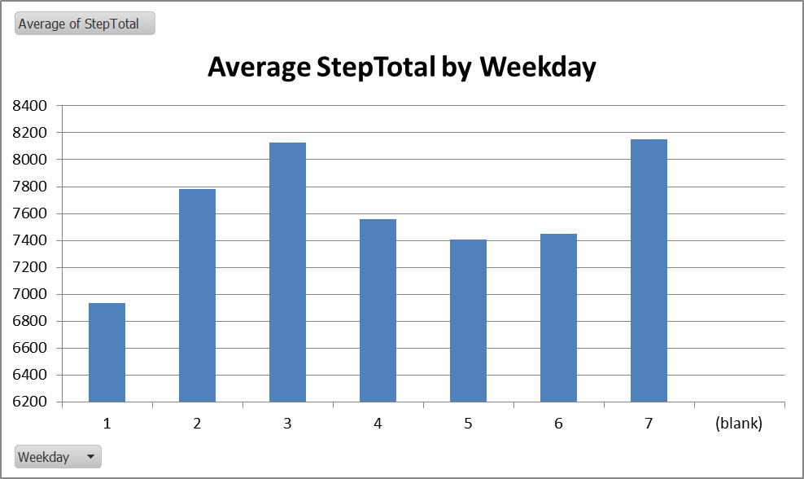
Date converted to Weekday
Highest number of steps on Tuesdays and Saturdays
Lowest number of steps on Mondays
(CC0: Public Domain, dataset made available through Mobius)

Slide 8
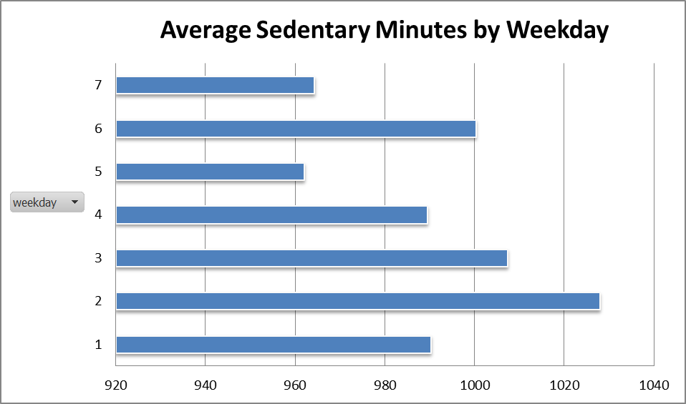
Least sedentary Saturdays
Most sedentary on Mondays
Consistent with trend in step totals
(CC0: Public Domain, dataset made available through Mobius)

Slide 9
What does it mean?
users most active/ least sedentary on saturday
Users tracking consistently daily, even when activity is low & calories are high
It’s possible the people who use smart fitness devices are regular, everyday, working women making small steps to be healthier

Slide 10
Recommendations
What should the business do now?
Earn the trust & attention of everyday, busy women
Offer services that reward small wins and consistency
Create community between users to encourage client success & membership retention

